Slide 1

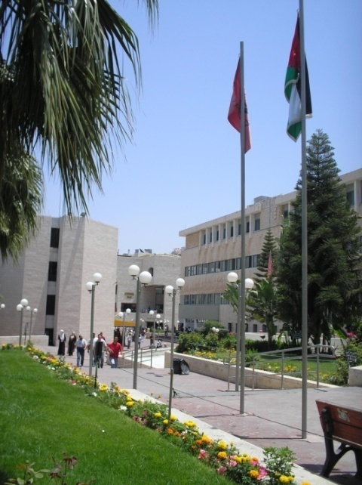

Teaching Decision Making:
Providing Hands-on Geographic Information System (GIS) Education to Support Urban Planning Research.
Palestinian Faculty Development Program –
2010 Academic Colloquium
University of Florida
University
Of Florida
Abdulnaser Arafat, Ph.D. Candidate
University of Florida
Faculty Member (On Ph.D. Study Leave)
Birzeit University
Ruth L. Steiner, Ph.D. Associate Professor
University of Florida
An-Najah
University

Slide 2
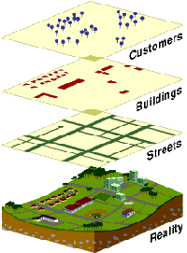
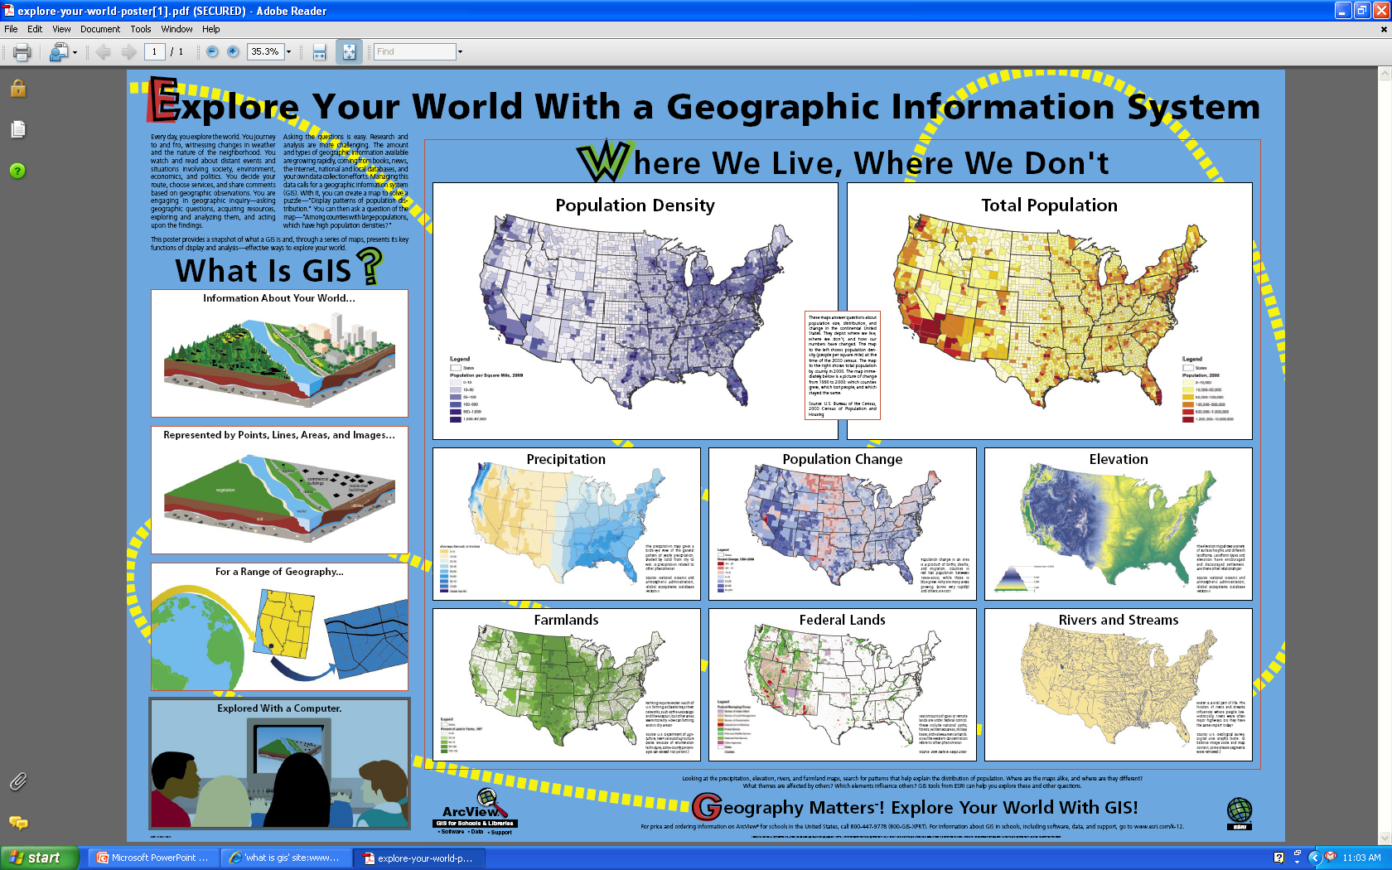
What is GIS?
A computer-based system that captures, stores, analyzes, manages, and presents data that is linked to location.
store
People
Buildings
Streets
Reality
2
Source: ESRI

Slide 3
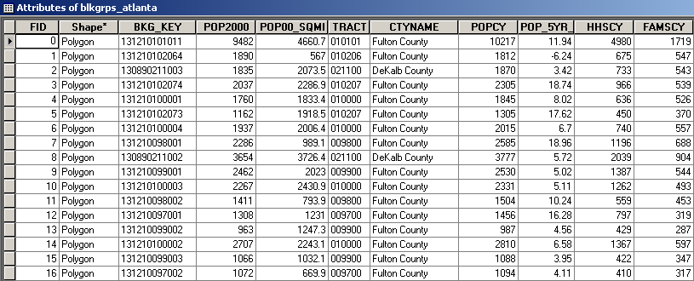
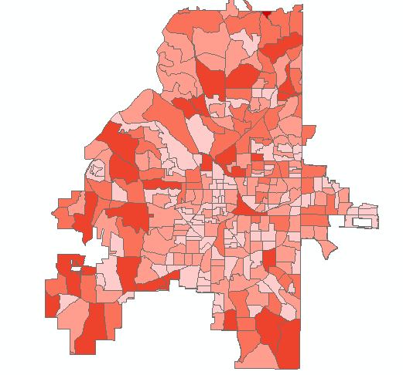
GIS Data Types
Spatial (geographic) – where?
Attribute (descriptive) – what?
Source: TPL Greenprinting Analysis Unit

Slide 4
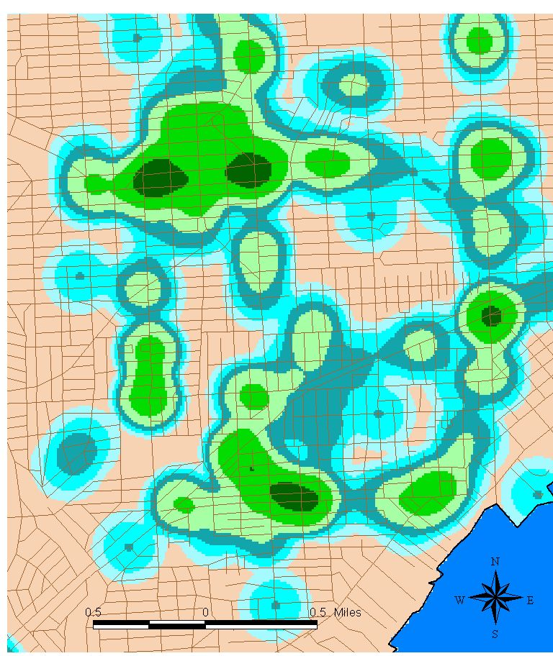
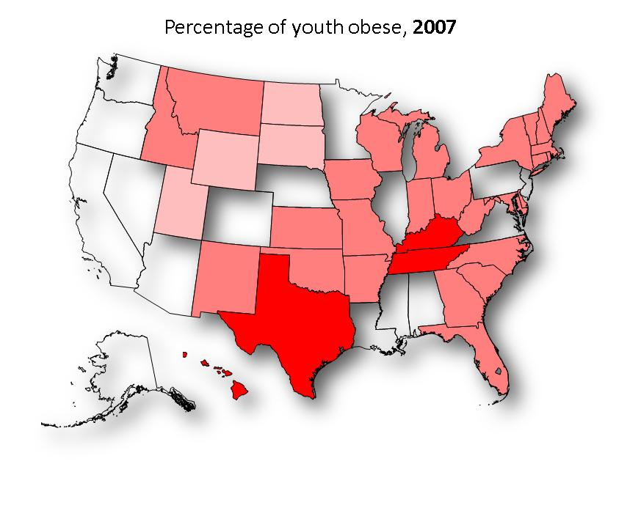
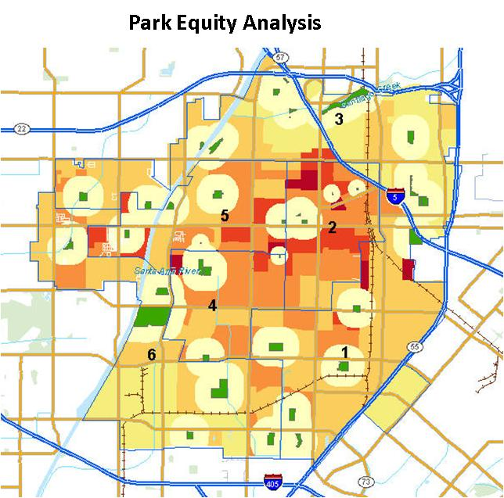
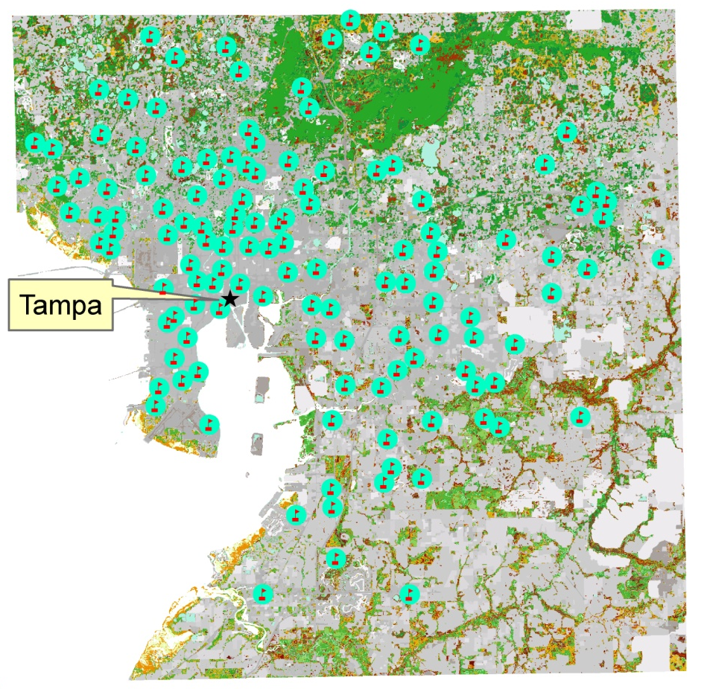
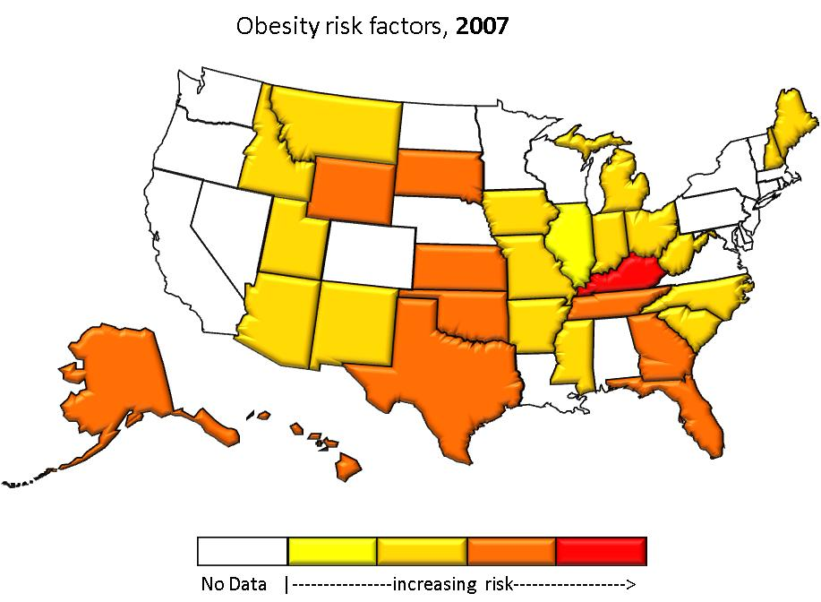
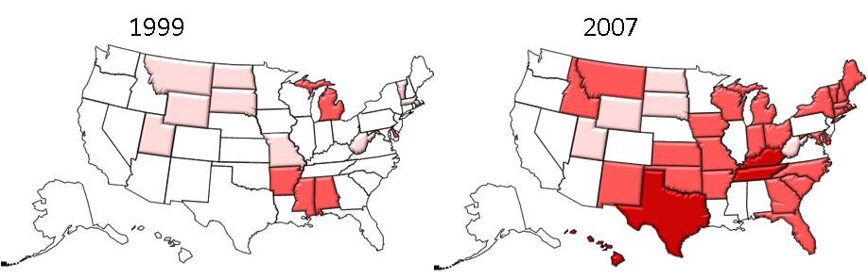
What Can GIS Do?
Visualize Data
Show Relationships among Multiple Factors
Detect and Monitor Change
Make Comparisons among Political Jurisdictions
Examine Local Areas
Visualize Disparities
Show Densities in Data
4

Slide 5
Methods of GIS Teaching
(LeGates, 2005)
Operation models
  “Step-by-step” training
Concept models
  Teaching GIS and spatial analysis concepts.
Teach with GIS model
  Using GIS to teach other subjects
  Issue-Based Model
Notes:
The differences between these models are mainly on the level of teaching theory and the involvement of students in running applications, using the theoretical and practical experience to solving research and real world issues.

Slide 6
How Hands-On Teaching is Defined?
Hands-on GIS teaching in this paper implies :
Students use the GIS software in the classroom
Use GIS to solve real world issues
Students solve their research problems in class.
Instructor uses video conferencing and other communication software to stay connected outside of class.
Notes:
This approach uses the concepts of the issue based teaching and extend it to incorporate working on research matters.

Slide 7

Needed Resources for successful Hands-ON GIS Teaching
Software/Hardware
Other resources:
  Research (Projects and Data)
  Connection to “real world” planning projects
  Time (Teaching/ research commitment)
  Academic support (Library books and research journals)
  Research centers affiliated with the department

Slide 8
GIS and Decision Making
GIS and spatial analysis are used to facilitate the decision making process for urban planners.
Automated GIS models
  Alternatives Analysis/Scenario planning
  Facilitates decision making and community participation
Notes:
This research focus on the hands-on GIS teaching for urban planners

Slide 9
Hands-On GIS Resource Comparison
Urban and Regional Development Program
Birzeit University
Urban and Regional Planning Program
An-Najah National University
Hands – On GIS Teaching
Resource Comparison
Urban and Regional Planning Program
University of Florida

Slide 10
Why Was the University of Florida Chosen?
Typical of planning programs in the United States
  10 faculty members (minimum 3, maximum ~20)
  Land grant, state university
  Major doctoral research university
  Member of AAU
Personal knowledge of university
Pilot Study

Slide 11
Pilot Study
Review of websites
Personal communication with faculty members
Review of the context of urban planning programs
A pilot study questionnaire
  Not yet completed

Slide 12
RESULTS

Slide 13
Course Comparison
University of Florida | Birzeit University | Annajah University
Survey of Planning Information Systems. | Geographical Information systems (GIS) | Geographic Information Systems (GIS)
Customizing Planning Information Systems: |  | Advanced GIS for Planners.
Advanced Planning Information Systems
Land Use Modeling
Spatial Modeling
GPS for Planners
Spatial Database Design and Development
Planning Information Seminar
Notes:
Mention that GIS is also used by the students in other classes and in their research and thesis/ dissertation work in the UF

Slide 14
Research Centers
University of Florida | Birzeit University | Annajah University
GeoPlan Center |  | Center of Urban and Regional Planning CURP
Center of Health and Built Environment
Center for Building Better Communities
Center for Environmental Planning and Design in the Americas
Center for Multimodal Solutions to Congestion Mitigation
Shimberg Center for Housing Studies
Center for Collective Protection
Notes:
Speak briefly about the centers in the University of Florida

Slide 15
Comparison of Resources
Criteria | University of Florida | Birzeit University | Annajah University
Availability of software. | ArcInfo , ArcGIS Server | ArcView | ArcInfo
Availability of research projects. | Research projects on national, state and local levels | Limited research | Limited research
Availability of data. | Available from many sources | Data is usually difficult to obtain | Data is usually difficult to obtain
Availability of hardware. | Departmental/University labs, servers, laptop requirement for students | labs | labs
Availability of the development funds. | Available | Not easy to obtain | Not easy to obtain
Teaching/ research load combination. | 2-4 Courses a year | 8-12 Courses a year | 8-12 Courses a year
Availability of Library books and research Journals | Books, journals, electronic journal access | Limited books, journals and electronic journal Access | Limited books, journals and electronic journal Access
Notes:
Focus on the research projects and funding

Slide 16
GIS in US Planning Programs
GIS in US Planning Programs
90 Urban Planning programs in the US
130 Faculty in 73 programs identify GIS as specialty
  34 with one faculty member
  24 with two faculty members
  15 with more than two faculty (UF & MIT with 4)
16 with GIS/Spatial Analysis Specialization
2 with university-wide GIS certificate

Slide 17
Discussion
Conclusion:
“The urban and regional program in the University of Florida has more resources to perform the hands-on geographic information systems teaching as well as the research involvement of graduate students”

Slide 18
Discussion
Research and development funds
Technology resources:
  Computer resources
  Audiovisual, video conferencing equipments, and online communication software
  No GIS License to install ArcGIS on personal computers
  Students are not required to have laptops or personal computers.
Teaching/Research load of faculty
Faculty development programs and student scholarships

Slide 19
Limitations of the Study
Use of websites as data source
  Personal knowledge as other data source
Delay due to need for Institutional Review Board approval of survey
Ability to generalize from this limited sample.
Notes:
One of the authors in this paper (Abdulnaser Arafat) served as a faculty member in Birzeit University and had taught GIS. According to him, Professors make a great effort to teach GIS. They strive in their mission because of the lack of financial, data and time resources. A faculty member usually take overtime teaching load because of the shortage in specialized human resources which mainly reduce the time available to conduct research.

